Slide 1
MySQL Lab
Managed to create the challenge #1 & #2
Challenge #1 saved on Google Drive and also in the same folder
Challenge #2 in PHP Admin

Slide 2
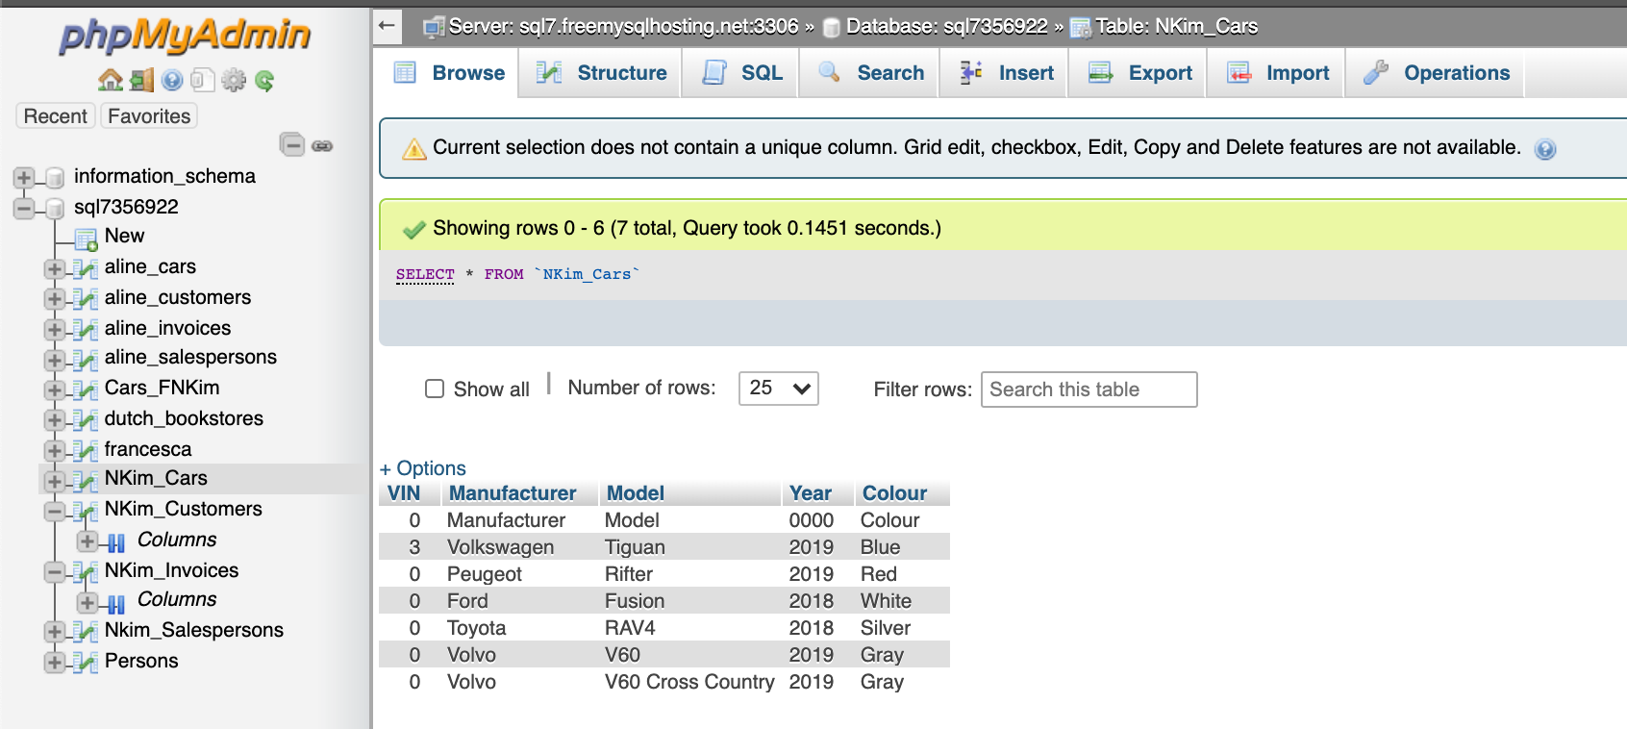
Managed to insert the dummy data into this table “Car”

Slide 3
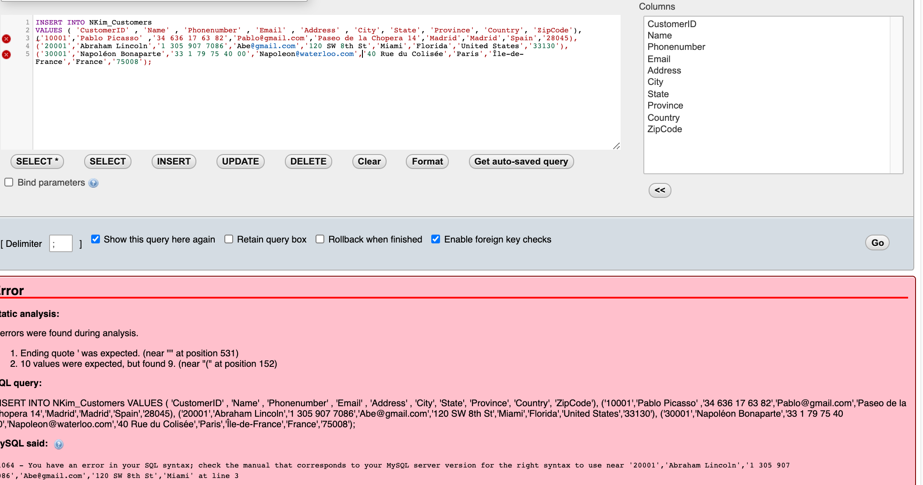
Afterwards, I couldn’t insert any of the tables despite using the same queries for the first table

Slide 4
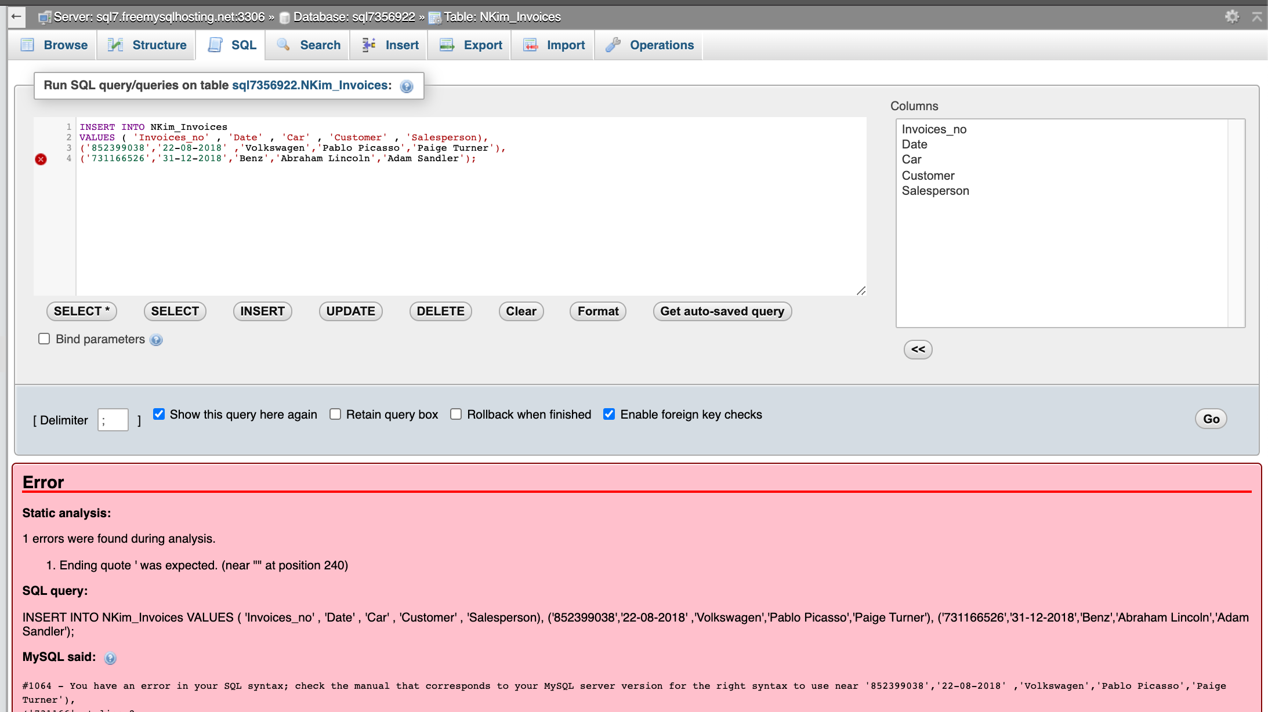
Afterwards, I couldn’t insert any of the tables despite using the same queries for the first table

